Slide 1
Normal Forms
Session 06
Rico Halim, S.Kom., M.Kom.

Slide 2
Learning Outcomes
Session 6
At the end of this session, students will be able to:
LO 2: Explain the concepts of relational algebra, data manipulation language, and transaction management on database

Slide 3
outline
Session 6
Normalization of Relations
First Normal Form (1NF)
Second Normal Form (2NF)
Third Normal Form (3NF)
Boyce-Codd Normal Form (BCNF)
Denormalization: When to Break the Rules
Putting It All Together

Slide 4
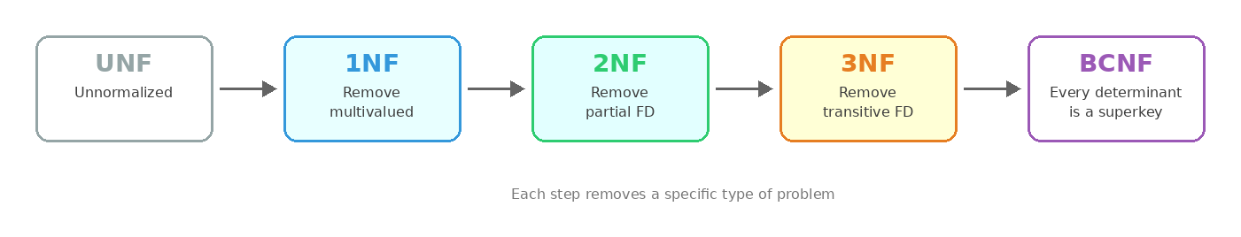
Normalization of Relations
Redundancy
Normalization: a systematic process of decomposing relations based on their FDs and primary keys
Goal: minimize redundancy, eliminate insertion/deletion/update anomalies
The process is incremental — each normal form removes a specific type of problem:

Slide 5
First Normal Form (1NF)
What is 1NF?
1NF is part of the formal definition of a relation
A relation is in 1NF if every attribute contains only single atomic (indivisible) values
Disallows: sets of values, repeating groups, or multiple values in a single cell
A table that violates 1NF is called unnormalized (UNF)

Slide 6
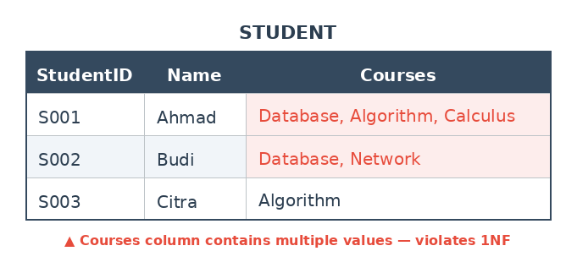
First Normal Form (1NF)
Example: Violation of 1NF

Slide 7
First Normal Form (1NF)
Why is this a problem?
"Find all students taking Database" → WHERE Courses = 'Database' won't match Ahmad or Budi, we need LIKE '%Database%' (unreliable, fragile)
"Count how many courses each student takes" → impossible with simple SQL, need string parsing
"Remove only Algorithm from Ahmad" → must manipulate the string manually, error-prone

Slide 8
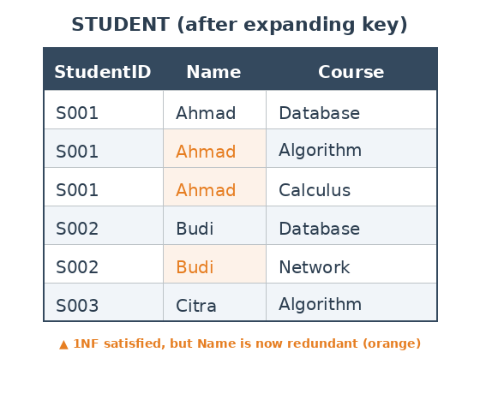
First Normal Form (1NF)
Solution 1: Expand the Key
Now every cell is atomic, satisfying 1NF
But a new problem appears: Name "Ahmad" is repeated 3 times (redundancy). If Ahmad changes name, we must update 3 rows.
This solution is valid but not ideal

Slide 9
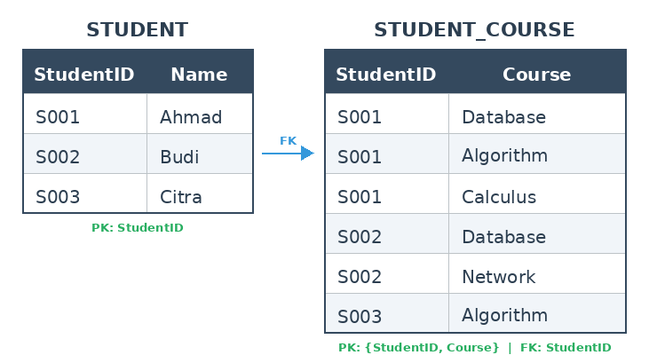
First Normal Form (1NF)
Solution 2: Decompose into separate relations (recommended)
Each table stores one fact about one entity
No redundancy in Name
PK of STUDENT: StudentID
PK of STUDENT_COURSE: {StudentID, Course}
StudentID in STUDENT_COURSE is a FK referencing STUDENT

Slide 10
Second Normal Form (2NF)
What is 2NF?
A relation is in 2NF if it satisfies 1NF and every non-key attribute is fully functionally dependent on the entire primary key
No partial dependency: no non-key attribute depends on only part of a composite key
If the primary key is a single attribute, a 1NF table is automatically in 2NF
2NF only matters when the primary key is composite (two or more columns)

Slide 11

First Normal Form (2NF)
Solution 1: Expand the Key
PK is composite: {StudentID, Course}
Grade depends on the full PK (need both StudentID and Course to determine a grade)
But CourseLecturer depends only on Course, not on the full PK. This is a partial dependency
"Mr. Said" appears in every row where Course = "Database". If Mr. Said is replaced, we must update multiple rows

Slide 12
Second Normal Form (2NF)
Identifying the FDs
FD1: {StudentID, Course} → Grade (full dependency [Accepted])
FD2: Course → CourseLecturer (partial dependency [Not Accepted], only part of PK)
Grade needs both StudentID and Course. Different students can get different grades in the same course.
CourseLecturer needs only Course. No matter which student, "Database" is always taught by "Mr. Said“
FD2 is the problem. CourseLecturer does not depend on the full PK.

Slide 13
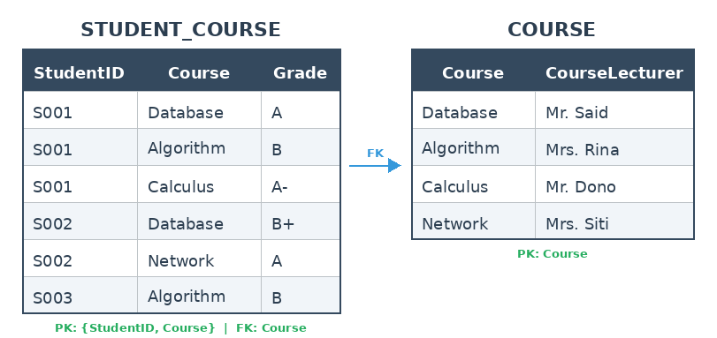
Second Normal Form (2NF)
Decompose to 2NF
CourseLecturer is moved to its own table where Course is the PK
"Mr. Said" now appears only once, no matter how many students take Database
If the lecturer changes, we only update one row in the COURSE table

Slide 14
Third Normal Form (3NF)
What is 3NF?
A relation is in 3NF if it satisfies 2NF and no non-key attribute is transitively dependent on the primary key
No transitive dependency: a non-key attribute must not depend on another non-key attribute
Pattern: PK → A → B, where A and B are both non-key. B depends on PK indirectly through A

Slide 15
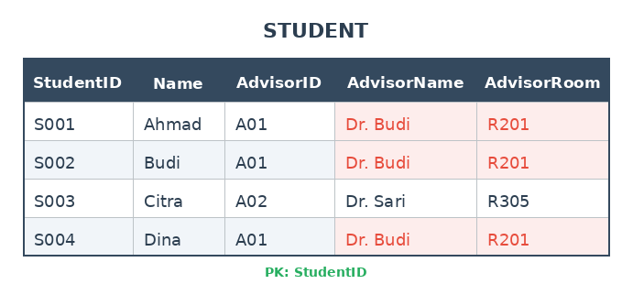
Third Normal Form (3NF)
Example: Violation of 3NF
PK = StudentID (single column, so already 2NF)
FDs:
  StudentID → Name, AdvisorID (direct from PK [Accepted])
  AdvisorID → AdvisorName, AdvisorRoom (non-key → non-key [not Accepted] transitive)

Slide 16
Third Normal Form (3NF)
Example: Violation of 3NF
PK is single column, so no partial dependency (already 2NF)
But AdvisorName and AdvisorRoom depend on AdvisorID, not directly on StudentID. This is a transitive dependency
"Dr. Budi" appears in every row where AdvisorID = A01. If Dr. Budi moves to a different room, we must update 3 rows

Slide 17
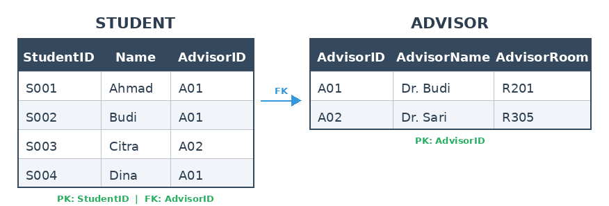
Third Normal Form (3NF)
Decompose to 3NF
AdvisorName and AdvisorRoom are moved to the ADVISOR table where AdvisorID is the PK
"Dr. Budi" now appears only once. If he moves to a different room, we update one row
Transitive dependency removed

Slide 18
Boyce-Codd Normal Form (BCNF)
What is BCNF?
A relation is in BCNF if for every non-trivial functional dependency X → Y, X is a superkey
BCNF is stricter than 3NF. Every BCNF relation is in 3NF, but not every 3NF relation is in BCNF
The difference only appears when there are overlapping candidate keys
In practice, most 3NF relations are already in BCNF

Slide 19
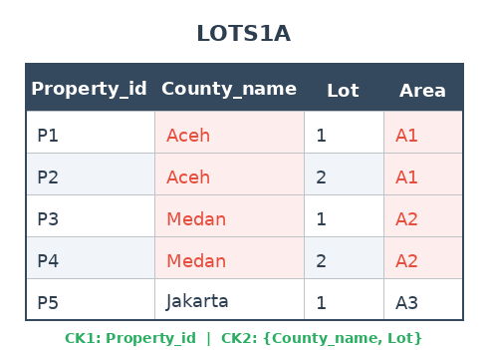
Boyce-Codd Normal Form (BCNF)
Example: Violation of BCNF
FDs:
  FD1: Property_id → County_name, Lot, Area
  FD2: {County_name, Lot} → Property_id, Area
  FD3: Area → County_name (each area belongs to exactly one county). FD3 is the problem. Area is not a superkey, but it determines County_name. This violates BCNF.

Slide 20
Boyce-Codd Normal Form (BCNF)
Example: Violation of BCNF
This is a rare case where 3NF is not enough
In practice, most 3NF tables are already in BCNF
BCNF violations only appear when there are overlapping candidate keys

Slide 21
Denormalization
When to Break the Rules
Normalization produces clean tables, but more tables means more JOINs
More JOINs can slow down read-heavy queries (e.g. dashboards, reports)
Denormalization = intentionally adding redundancy back for performance
Common scenarios:
  Reporting systems that run complex JOINs on every page load
  Data warehouses (star schema, snowflake schema)
  Read-heavy applications where data rarely changes (e.g. product catalogs)
Rule of thumb: normalize first, denormalize only with a measured reason

Slide 22
Denormalization
When to Denormalize
Frequently executed queries, queries that run thousands of times per day (e.g. dashboards, homepage feeds). Reducing JOINs saves time on every single execution
Large-scale JOIN operations, queries that JOIN many tables with millions of rows. Even if executed once a month, the volume makes it slow
Read-heavy applications, systems that read far more often than they write. Example: product catalogs in e-commerce are read thousands of times per second but rarely updated
Data warehouses and analytics, star schema and snowflake schema are intentionally denormalized so analysts can query fast without complex JOINs
Caching layers, storing pre-joined and pre-computed results so the system does not need to recalculate every time

Slide 23
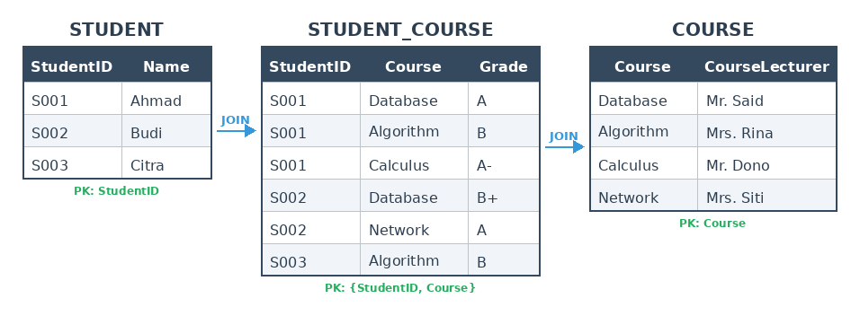
Denormalization
Example: Student Report Dashboard
After 3NF, we have 3 separate tables: STUDENT, STUDENT_COURSE, COURSE
To display a student report, we must JOIN all 3 tables every time

Slide 24
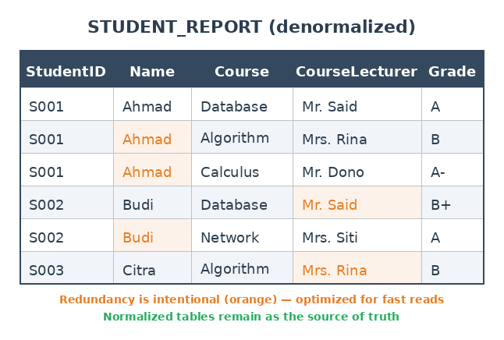
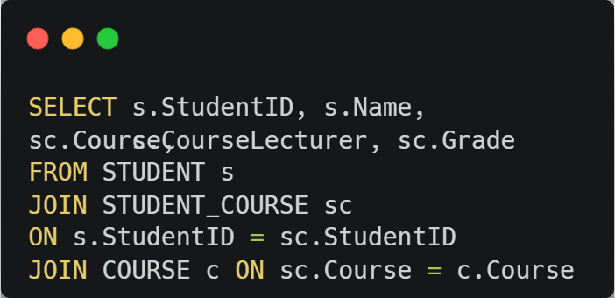
Denormalization
Example: The Denormalized Solution
Solution: create one denormalized table for reporting that combines all data

Slide 25
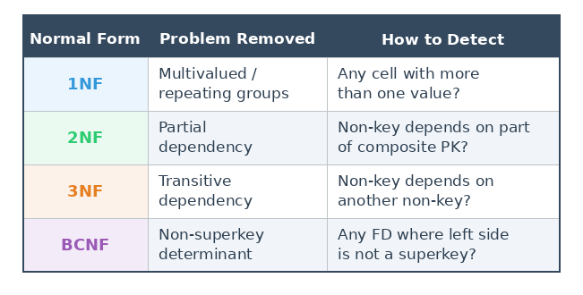
Putting It All Together
Summary Table

Slide 26
Summary
Normalization of Relations — A systematic process of decomposing tables based on FDs to minimize redundancy and eliminate anomalies.
1NF — Every cell must contain a single atomic value. No multivalued attributes or repeating groups.
2NF — No partial dependency. Every non-key attribute must depend on the entire composite PK, not just part of it.
3NF — No transitive dependency. Non-key attributes must not depend on other non-key attributes.
BCNF — Every determinant must be a superkey. Stricter than 3NF, but in practice most 3NF tables are already BCNF.
Denormalization — Intentionally adding redundancy back for performance. Normalize first, denormalize only with a measured reason.

Slide 27
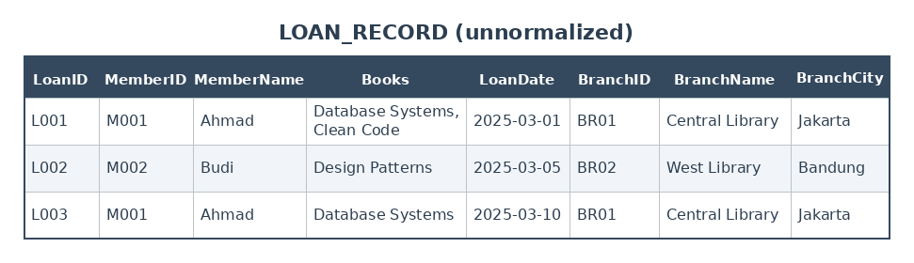
exercise

Slide 28
exercise
Identify the 1NF violation in this table. Decompose it to satisfy 1NF.
After 1NF, identify any partial dependencies. Decompose the table to satisfy 2NF.
After 2NF, identify any transitive dependencies. Decompose the table to satisfy 3NF.
Write the CREATE TABLE statements for your final 3NF result.

Slide 29
References
Session 6
Murach, J. (2023). Murach's MySQL, 4th Edition. Mike Murach & Associates. Chapter 10.
Elmasri, R. & Navathe, S. (2015). Fundamentals of Database Systems, 7th Edition. Pearson. Chapter 14.

